Slide 1
E-commerce store with Spring boot

Slide 2
Outline
Project structure
Testing
Unit tests
Integration tests

Slide 3
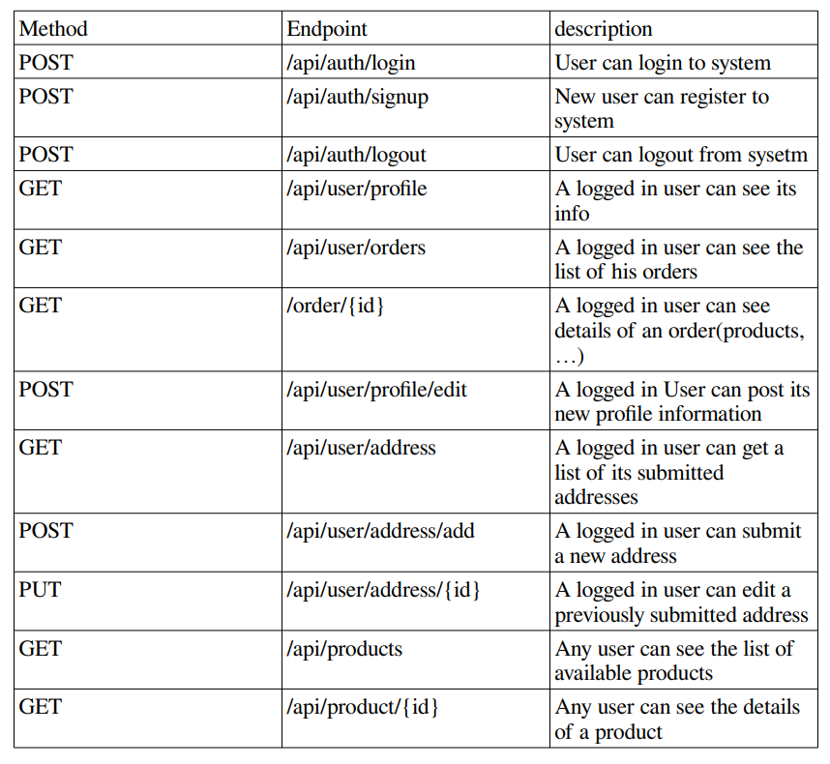
Endpoints

Slide 4
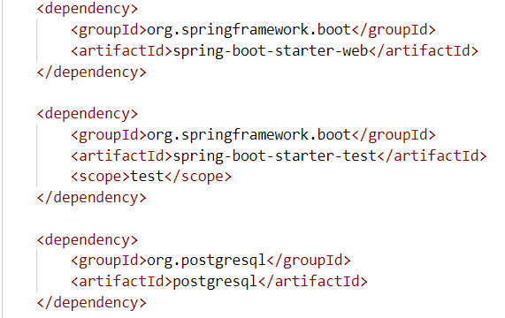
Technologies
Spring boot
Spring security
Postgresql

Slide 5
Models
User(id, firstName, lastName, phoneNumber, email, password)
Address(id, User, city, streetAddress, postalCode)
Product(id, name, price, category)
Order(id, User)

Slide 6
Controllers
UserAuthController(/api/auth/*)
UserAccountController(/api/user/*)
UserAddressController(/api/user/address/*)
ProductController(/api/products/*)

Slide 7
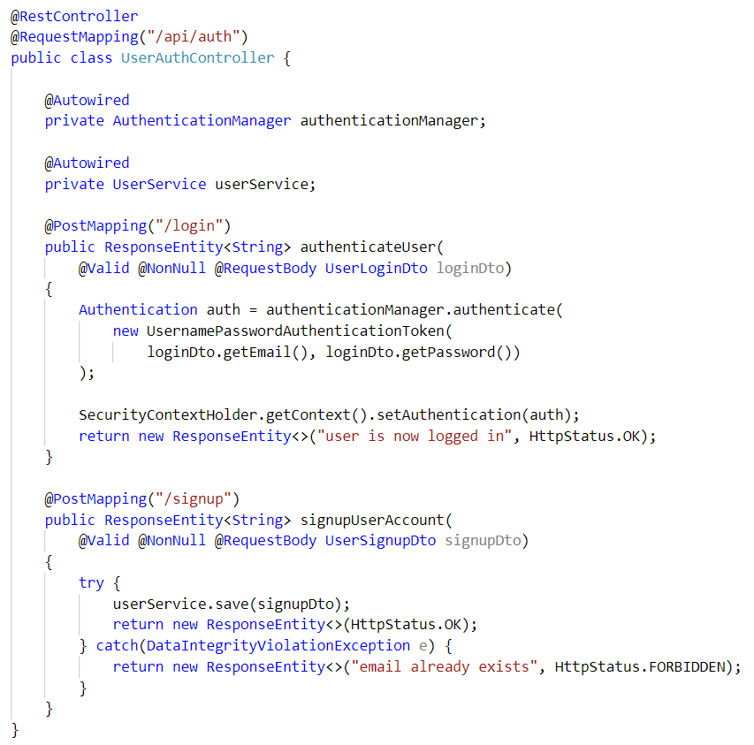
UserAuthController

Slide 8
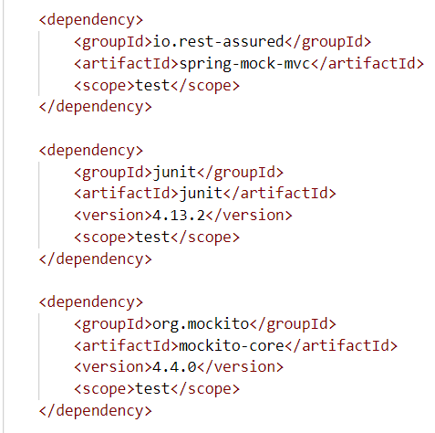
Unit test dependencies
Junit
Mockito
MockMVC
Spring boot starter test

Slide 9
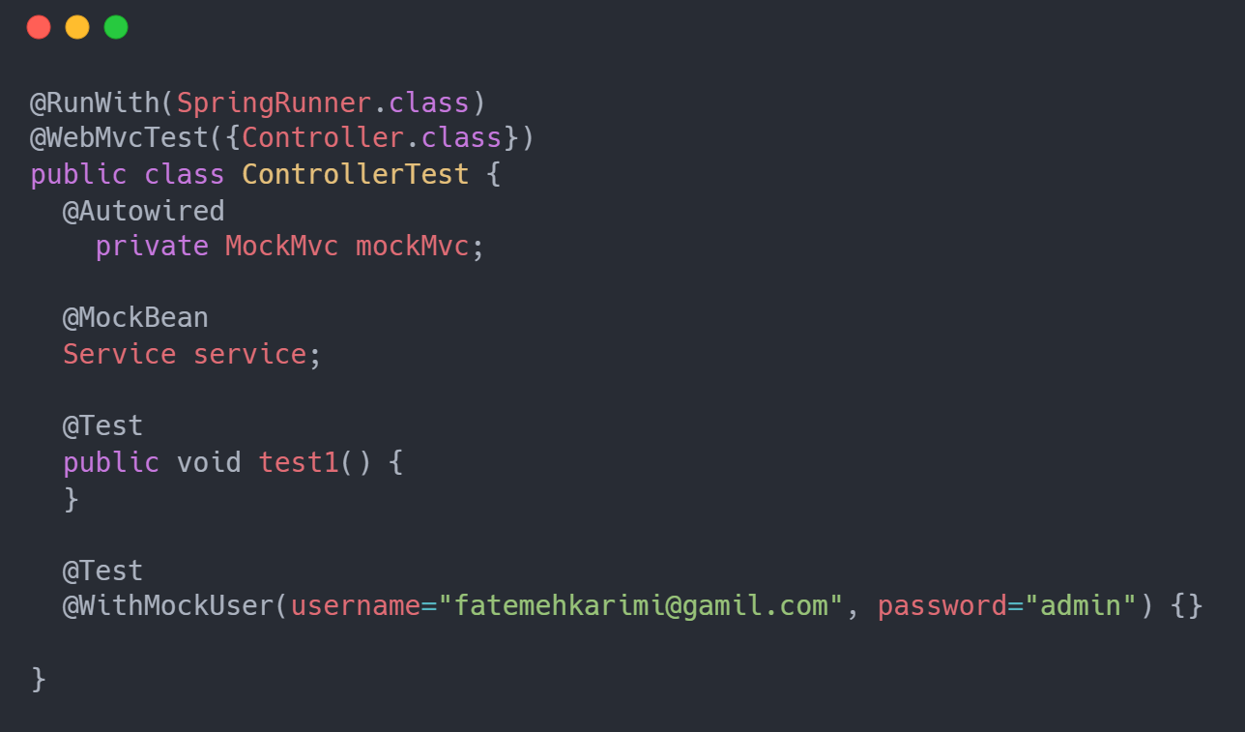
Unit test structure

Slide 10
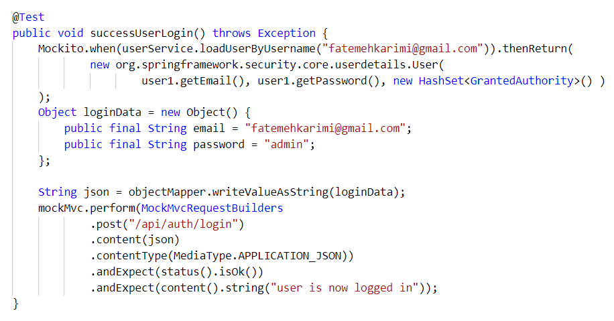
Example 1

Slide 11
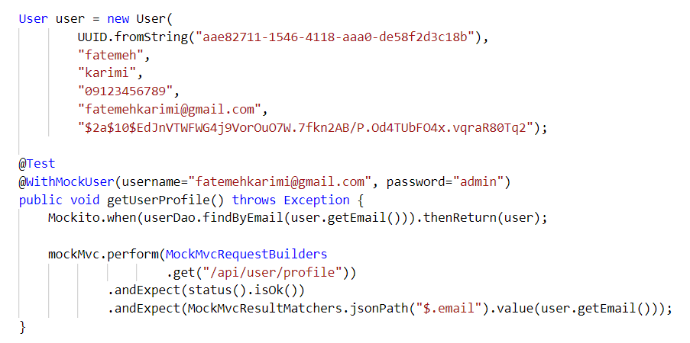
Example 2

Slide 12
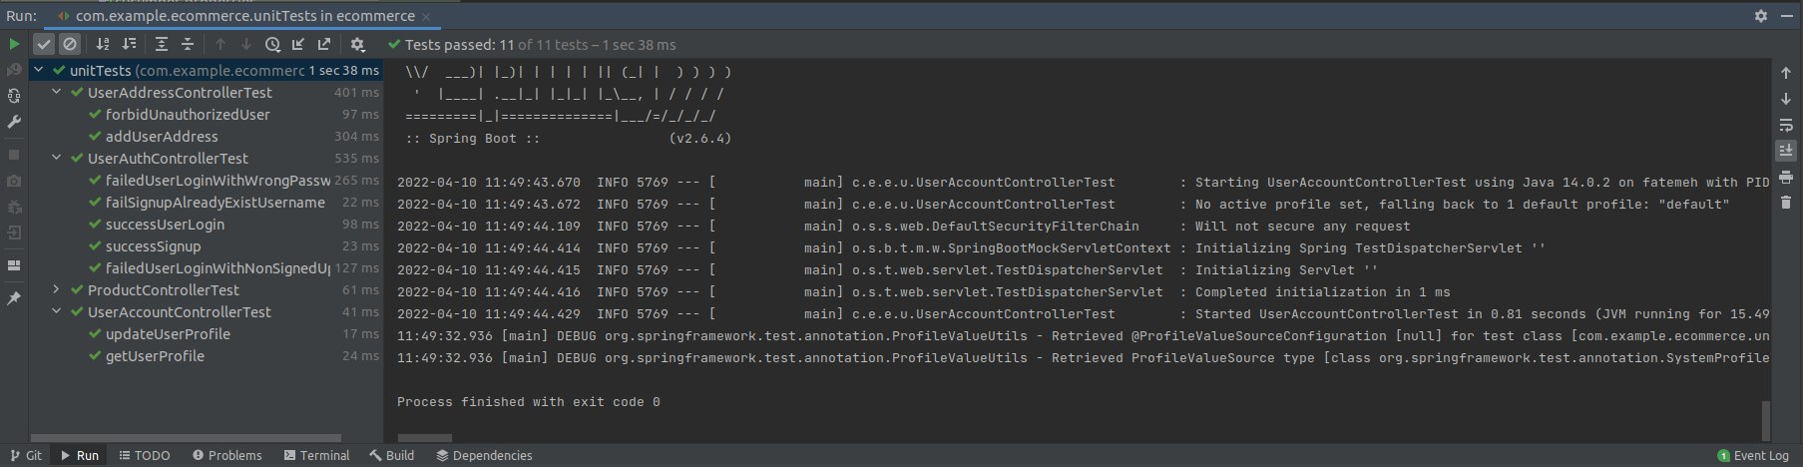
Running tests

Slide 13
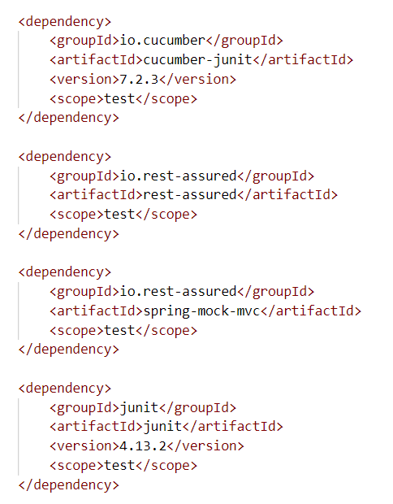
Integration tests dependencies
Junit
Rest-assured
Cucumber
Cucumber reporting

Slide 14
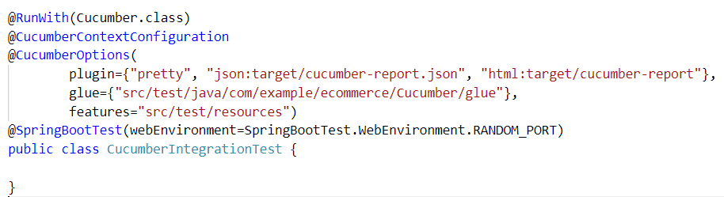
Configuration

Slide 15
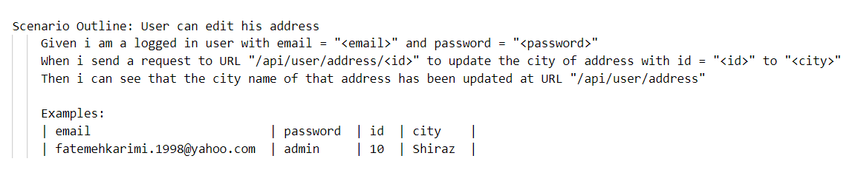
Gherkin test Scenarios

Slide 16
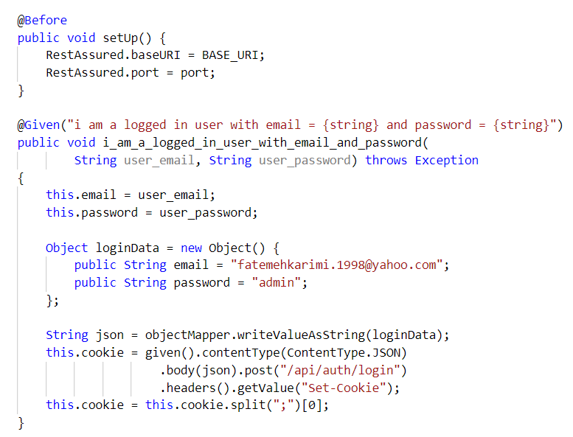
Given

Slide 17
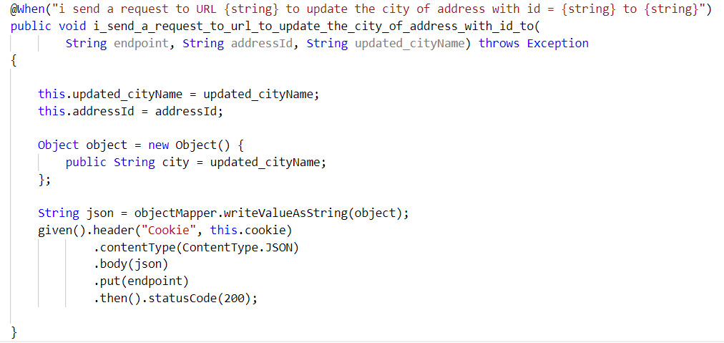
When

Slide 18
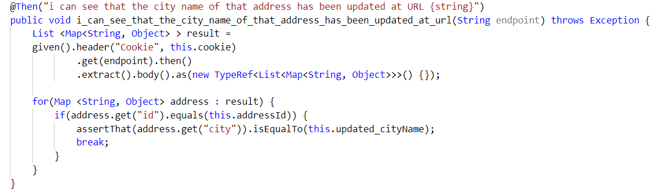
Then

Slide 19
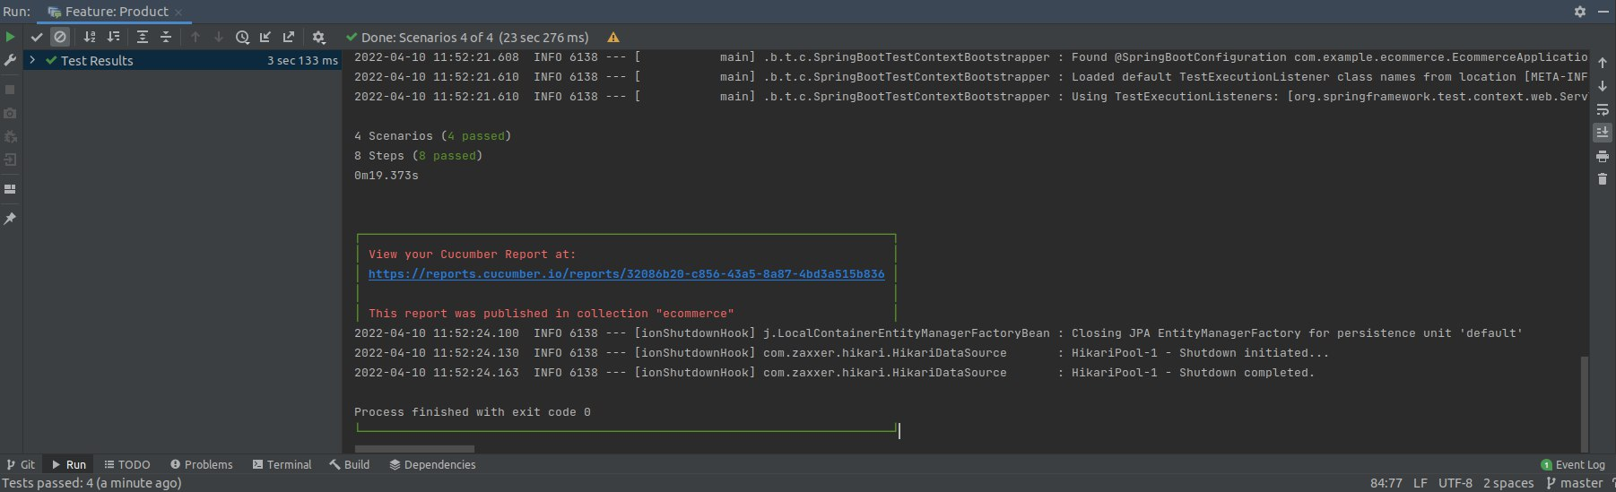
Results

Slide 20
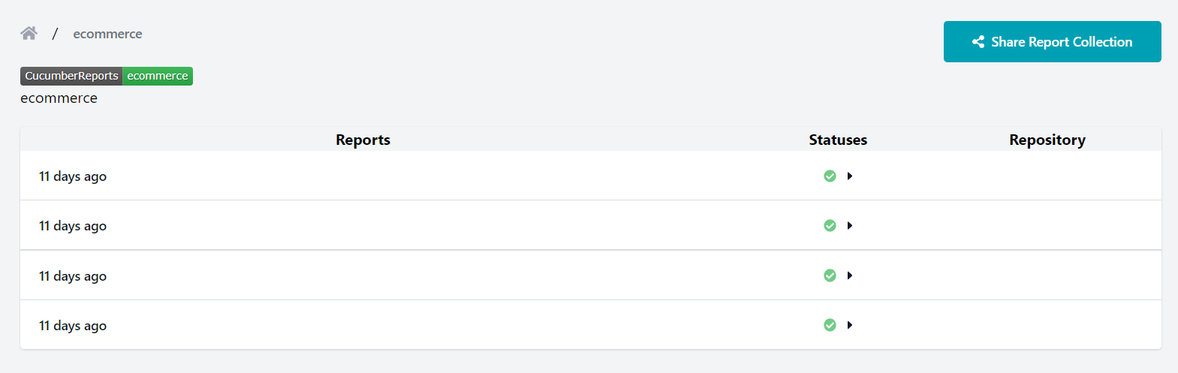
Reports
You can create a collection on cucumber website and keep your reports.

Slide 21
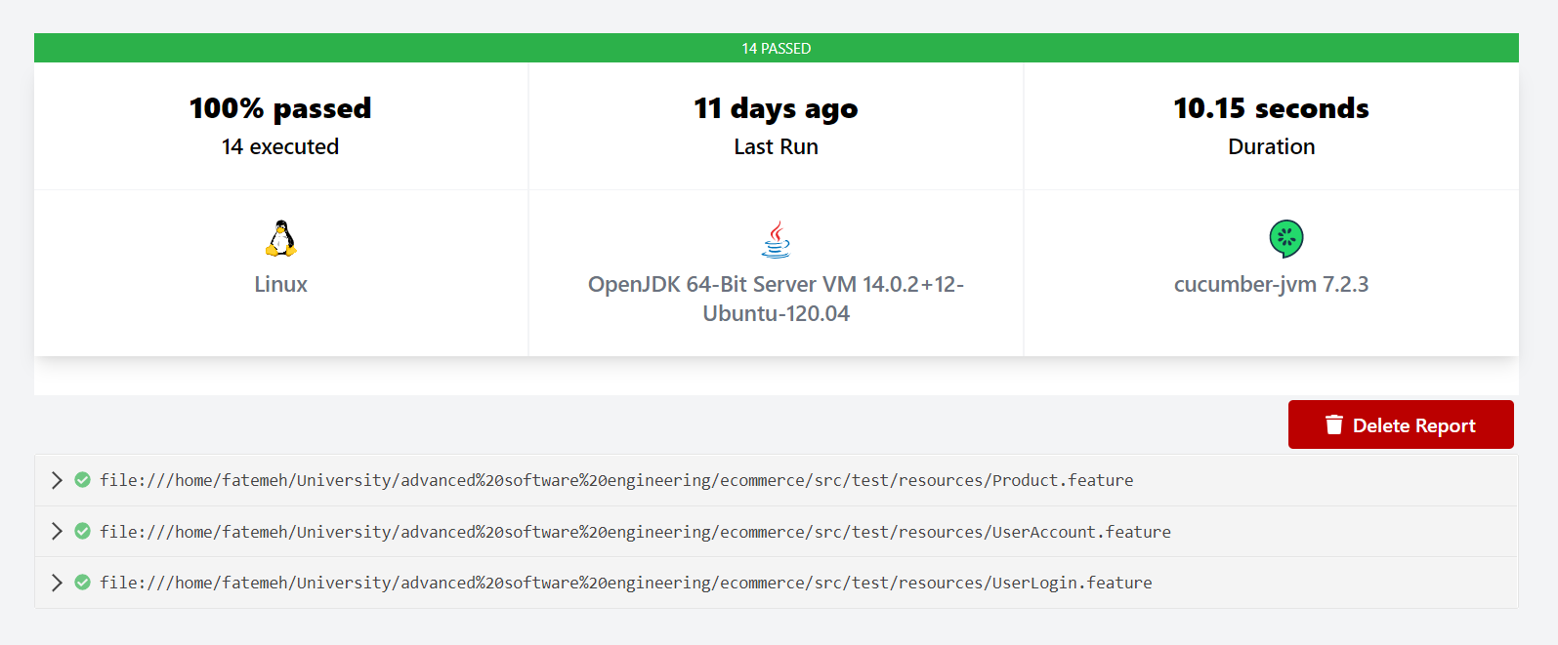
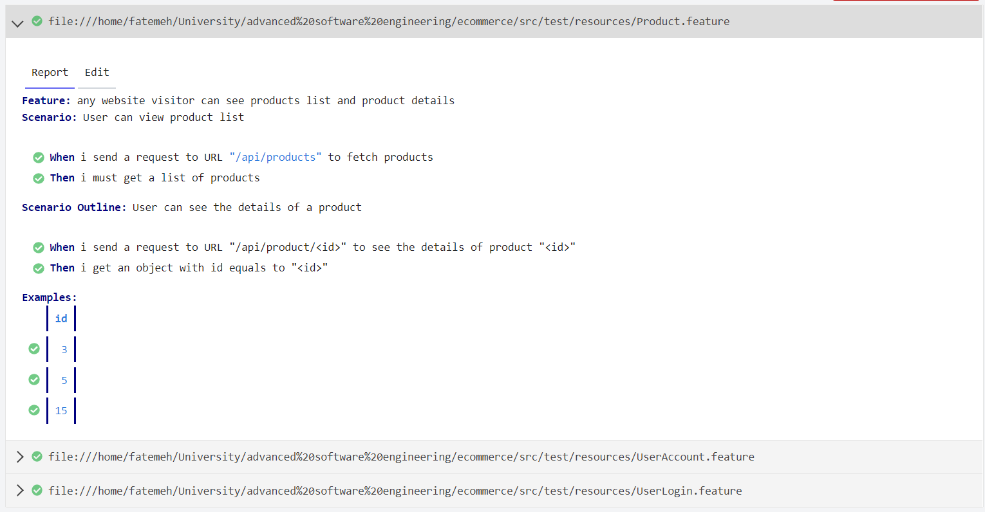
Reports

